Slide 1
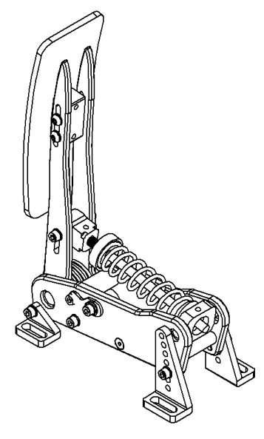
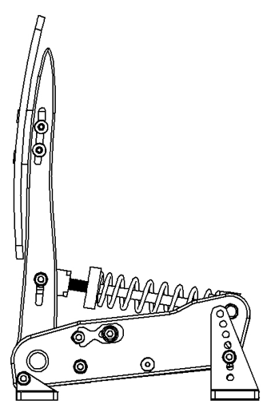
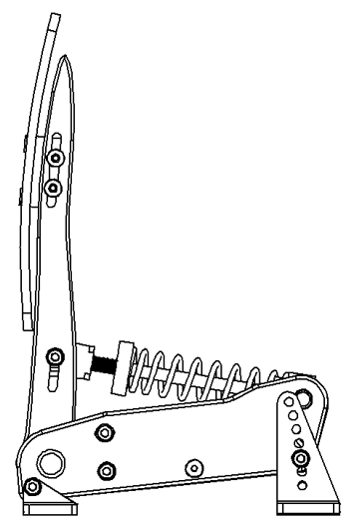
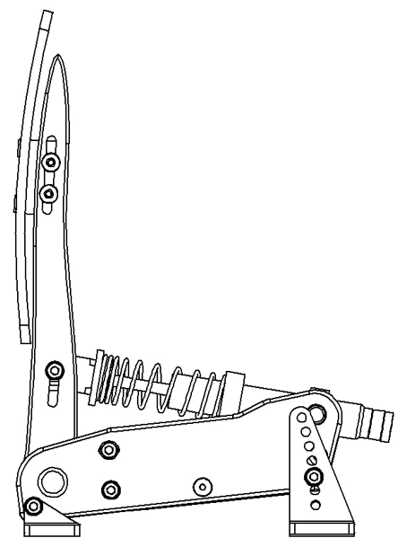
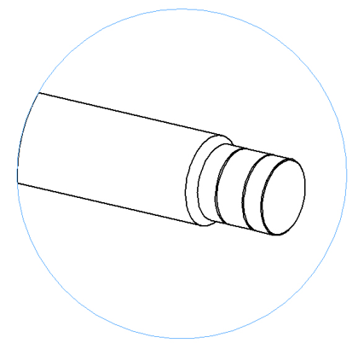


THROTTLE
Adjust pedal unit angle
Adjust travel range
Select the suitable angle. The manufacture provides 7 angle adjustment holes to set your pedal angle. Tighten the bolts to secure the angle brackets to the Throttle unit.
Step 1: Twist the spring cap to a high position
Step 3: Loosen the 4 bolts on both sides and move the top blue bump stop forward or backward to find your preferred pedal travel range.
Remove the two bolts and 4 washers
Step 2: Loosen the 2 bolts on the sides and move the bottom blue bump stop up or down, find your preferred recline angle then tighten the bolts
12º
9º
6º
3º
0º
-3º
-6º
Adjust the height of the pedal face
Adjust spring tension
Adjust damper levels
Twist the spring tension adjustment cap further to the front to reduce spring tension and further to the back to increase spring tension
Twist the end of the damper unit so that the white dot lines up with a number. 1 being the easiest to depress the pedal and 8 being the hardest to depress the pedal
Loosen the 4 screws on the sides behind the pedal face
Choose a suitable pedal height, then tighten the bolts.
3
4
2
1

Slide 2
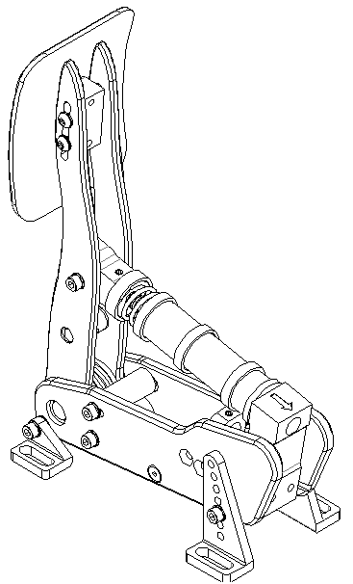
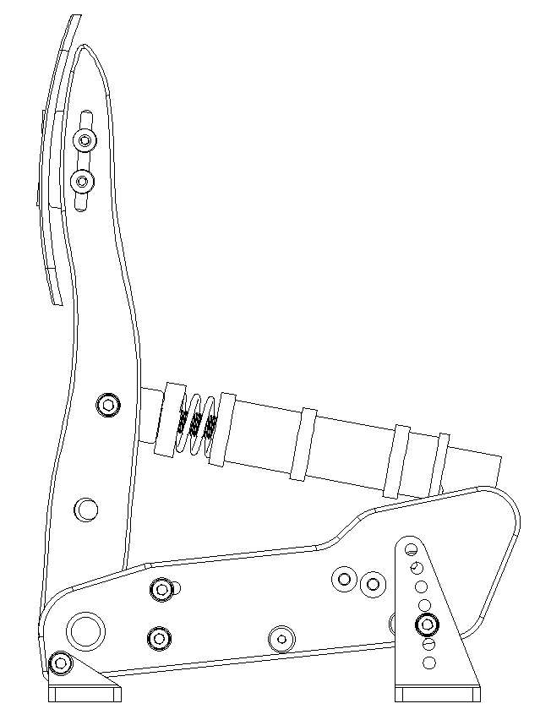
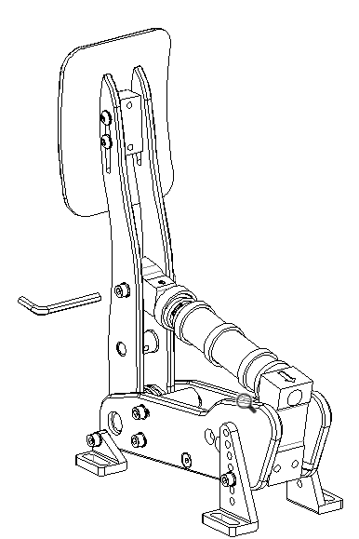
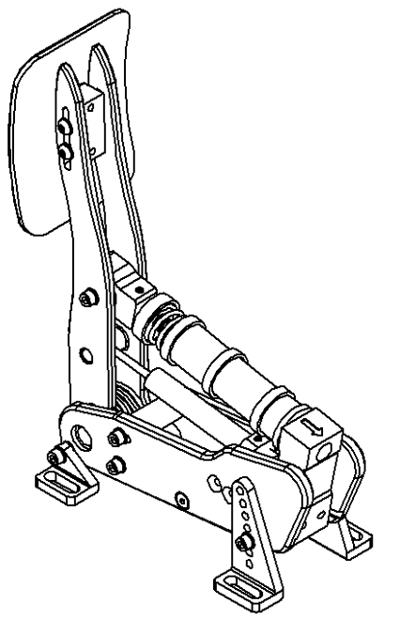
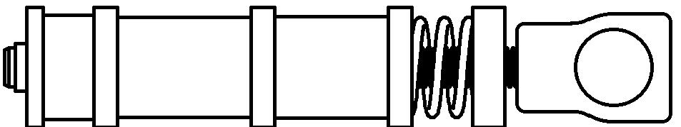

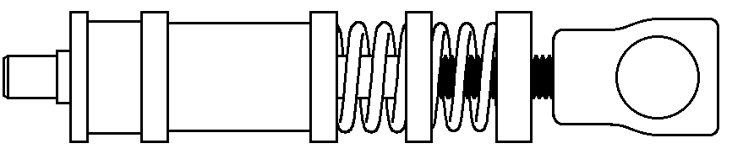
BRAKE
Adjust pedal unit angle
Adjust travel range
Select the suitable angle. The manufacture provides 7 angle adjustment holes to set your pedal angle. Tighten the bolts to secure the angle brackets to the Brake unit.
Step 1: Twist the spring cap to a high position
Step 2: Loosen the 2 bolts on the sides and move the bottom blue bump stop up or down, find your preferred recline angle then tighten the bolts
Step 3: Loosen the 4 bolts on both sides and move the top blue bump stop forward or backward to find your preferred pedal travel range.
Remove the two bolts and 4 washers
12º
9º
6º
3º
0º
-3º
-6º
Adjust the height of the pedal face
Adjust spring tension
Adjust damper levels
Loosen the 4 screws on the sides behind the pedal face
3 recommended combos include:
Twist the end of the damper unit so that the white dot lines up with a number. 1 being the easiest to depress the pedal and 8 being the hardest to depress the pedal
Choose a suitable pedal height, then tighten the bolts.
Twist the spring tension adjustment cap further to the front to reduce spring tension and further to the back to increase spring tension
Option 1: 2.5mm spring + 2 elastomers
Option 2: 3mm spring + 2 elastomers
Remove the bolts, change to a suitable elastomer combo, reinstall and tighten
3
4
Option 3: 2.5mm spring + 3mm spring + 1 elastomer
2
1

Slide 3
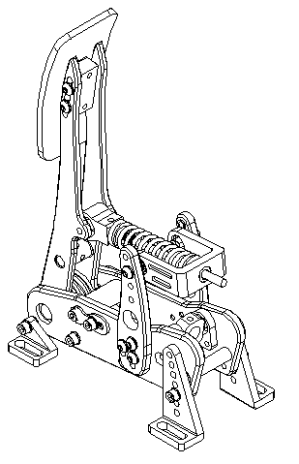
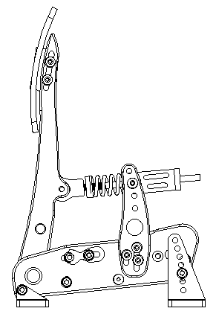
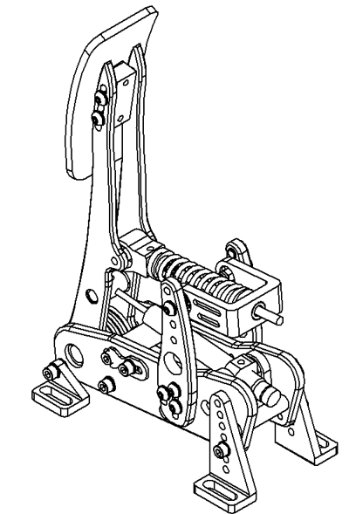
CLUTCH
Adjust pedal unit angle
Adjust travel range
Select the suitable angle. The manufacture provides 7 angle adjustment holes to set your pedal angle. Tighten the bolts to secure the angle brackets to the Clutch unit.
Step 1: Twist the spring cap to a high position
Step 2: Loosen the 2 bolts on the sides and move the bottom blue bump stop up or down, find your preferred recline angle then tighten the bolts
Step 3: Loosen the 4 bolts on both sides and move the top blue bump stop forward or backward to find your preferred pedal travel range.
Remove the two bolts and 4 washers
12º
9º
6º
3º
0º
-3º
-6º
Adjust the height of the pedal face
Adjust spring tension
Adjust damper levels
Loosen the 4 screws on the sides behind the pedal face
Twist the end of the damper unit so that the white dot lines up with a number. 1 being the easiest to depress the pedal and 8 being the hardest to depress the pedal
Choose a suitable pedal height, then tighten the bolts.
Twist the spring tension adjustment cap further to the front to reduce spring tension and further to the back to increase spring tension
3
4
2
1

